Slide 1

BECE202L - SIGNALS AND SYSTEMS
Home Automation Using DTMF Decoder
Mathesh
23BEC1152
Faculty
Dr Sivakumar S
Lokesh R
23BEC1009
Gautham R
23BEC1069
Slot: G1+ TG1

Slide 2
Table of Contents
Introduction - Principle Behind DTMF
Theory
Components Required
Block Diagram

Slide 3
Principle Behind DTMF
DTMF, or Dual-Tone Multi-Frequency, is a technology used in telecommunications to input information by pressing buttons on a keypad. When a key is pressed, two distinct tones are generated simultaneously: a row frequency and a column frequency. This combination of tones uniquely identifies the pressed key, allowing systems like automated customer service to interpret user input and provide appropriate responses.

Slide 4
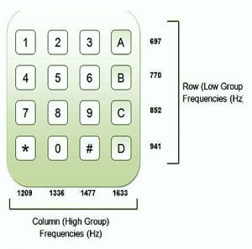
Theory/Working
DTMF employs a frequency-based
system where row frequencies are typically lower than column frequencies. To ensure accurate identification, these frequencies are selected to be harmonically distinct, preventing interference and misinterpretation. To compensate for potential audio system limitations, column frequencies are designed to be slightly louder than row frequencies, enhancing their clarity and reliability.

Slide 5
Components used
Arduino Uno
LED Strip
CPU Fan
Relay
DTMF Module
Aux Cable

Slide 6
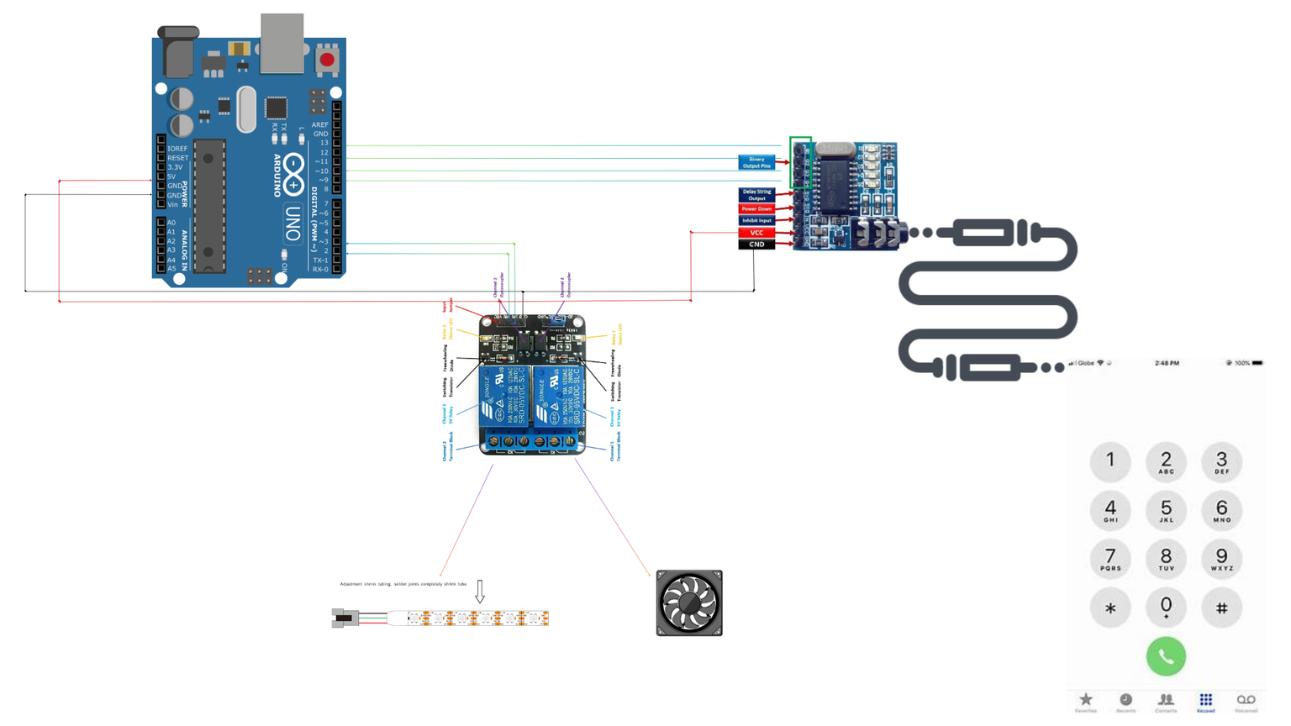
Block Diagram
Link for the Image
6

Slide 7
MATLAB Simulation
Concept behind: FFT and Hamming Window
DTMF Signal Generation and Frequency Spectrum Plotting
Enhanced DTMF Signal Generation, Decoding, Frequency Detection
Interactive keyboard input and DTMF signal (sound) generation
Interactive GUI-Based DTMF Keypad Code

Slide 8
THANK YOU!

